Slide 1
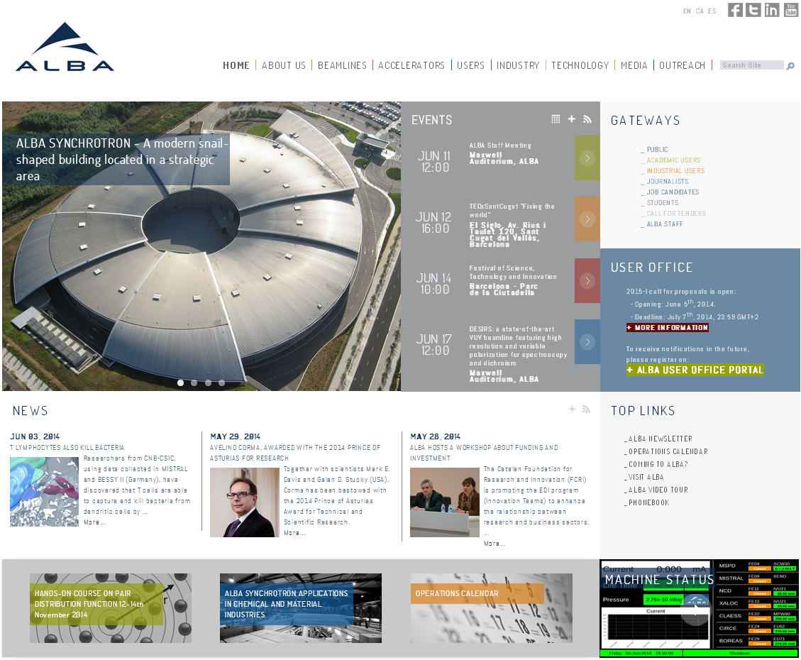
TITLE

Slide 2
Changes
New design
A public website totally separated from ALBA staff intranet website and internal applications.
New content management workflow
Multilingual

Slide 3
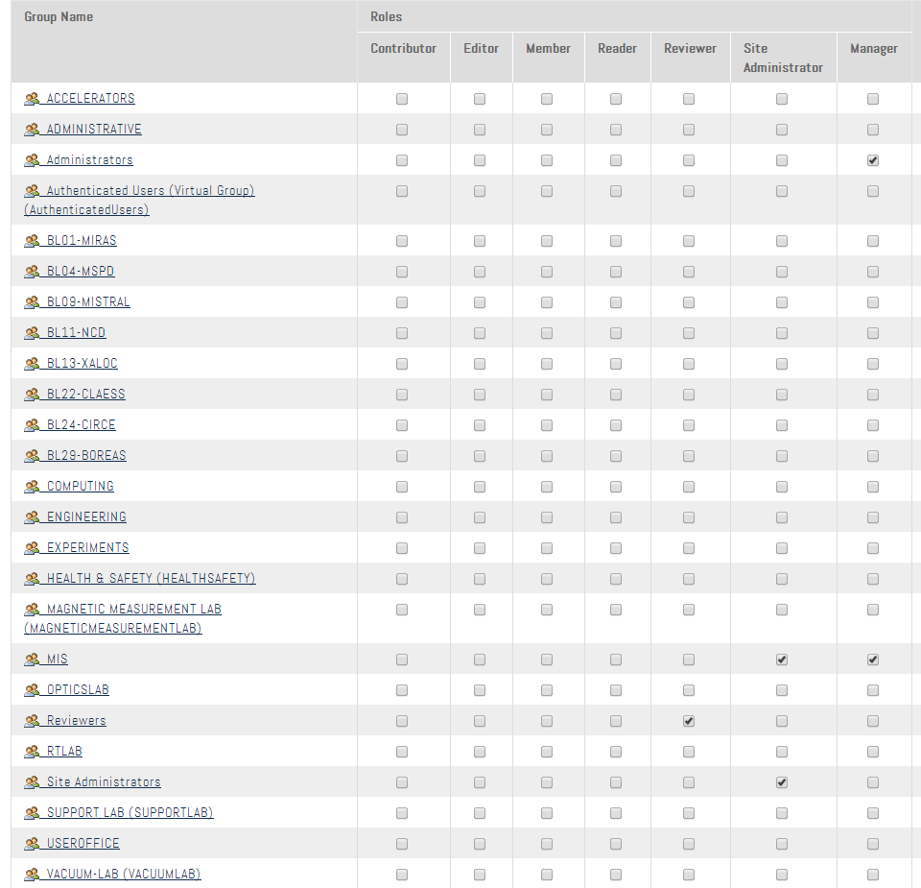
Groups

Slide 4
New Content Management Workflow for Content Creation
Private
Make private
Publish externally
Internal Draft
Pending Review
Internally Published
Externally Visible
Submit for publication
Publish internally
Publish externally
EDITORS CAN CREATE
& SUBMIT NEW CONTENTS
WEBMASTERS REVIEW & PUBLISH THEM

Slide 5
New Content Management Workflow for Content Modification
Internal Draft
Pending Review
Submit for publication
CHECK-OUT
EDITORS CAN CREATE A WORKING COPY TO MODIFY IT
WEBMASTERS REVIEW THE WORKING COPY AND PUBLISH IT
CHECK-IN
Externally Visible
v. 1
Externally Visible
v. 2

Slide 6
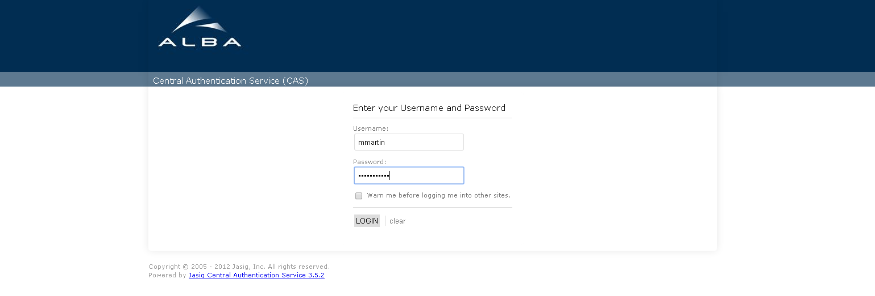
How to Login
Public webite ➔ no visible login area
www.albasynchrotron.es/caslogin
Login using your user account

Slide 7
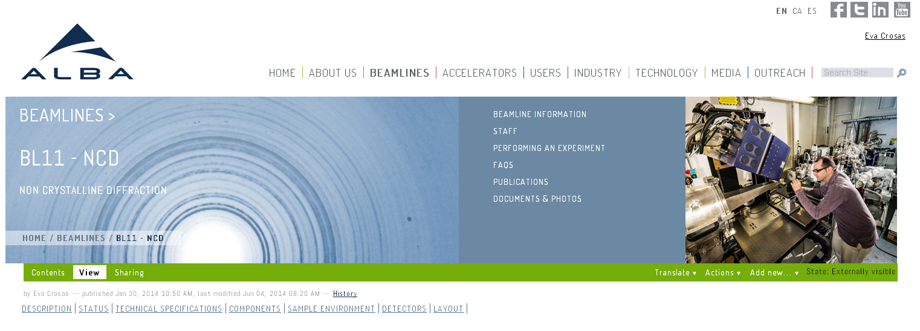
How to Add New Content

Slide 8
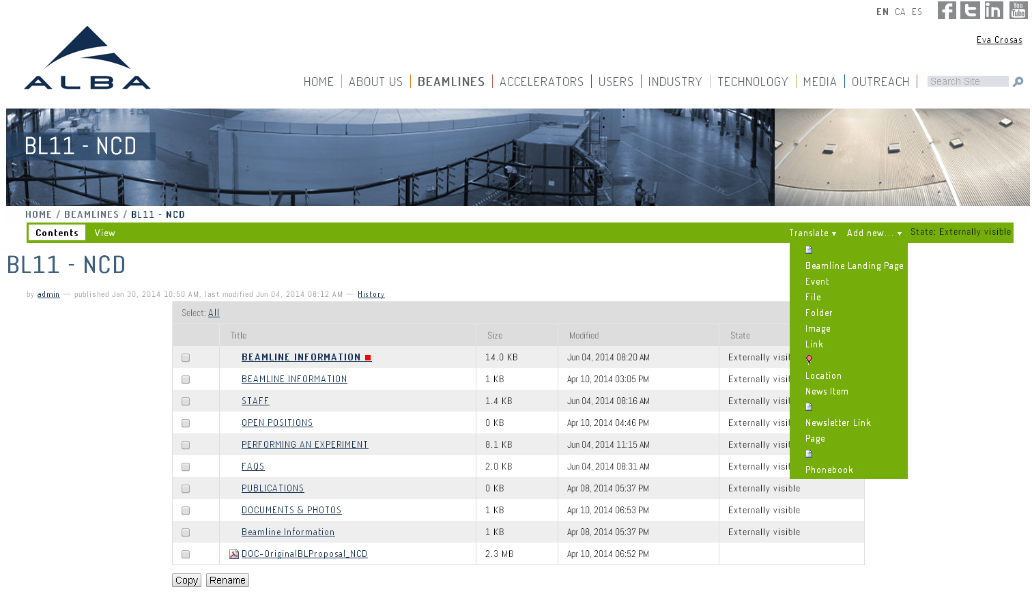
How to Add New Content

Slide 9
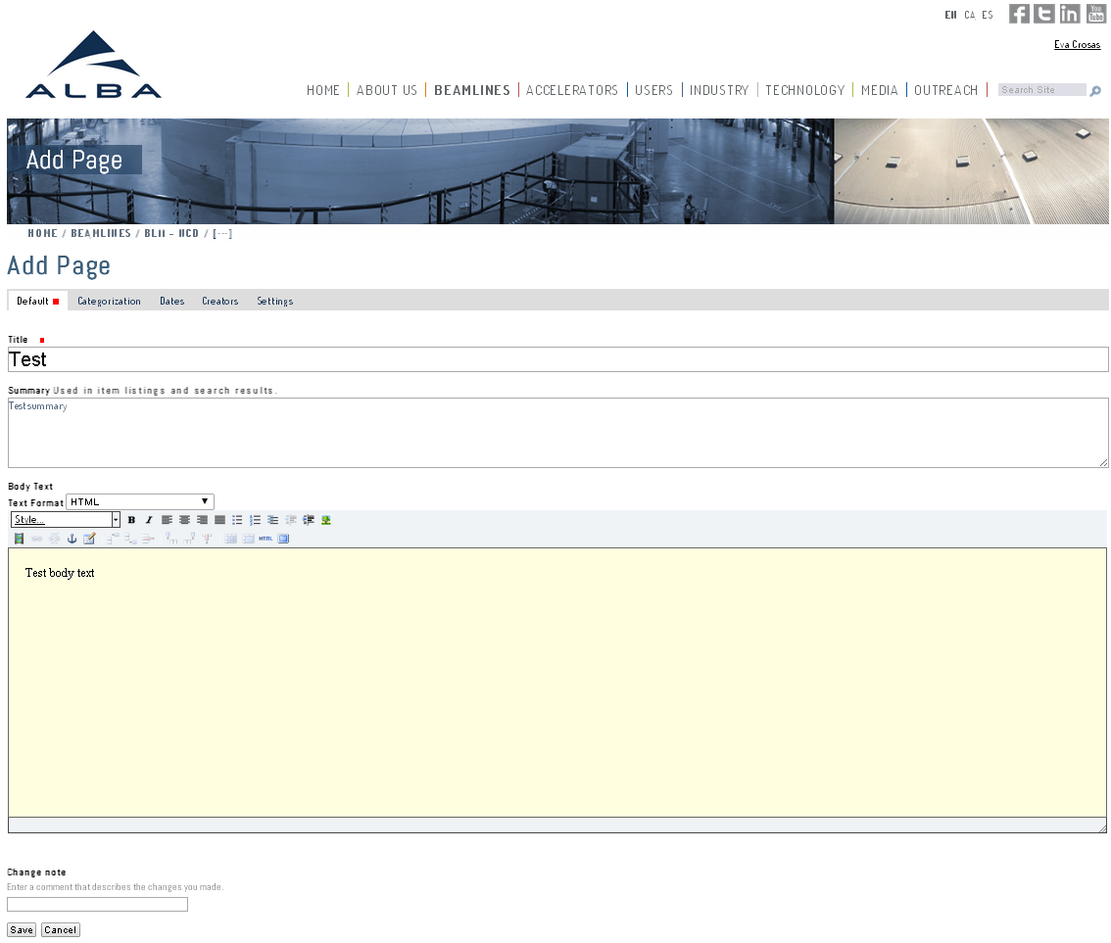

Slide 11
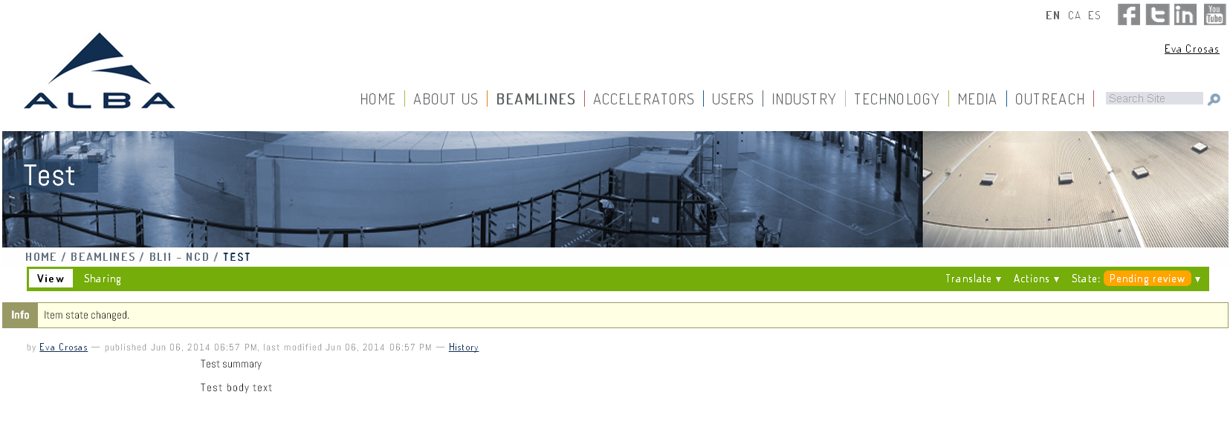
When submitting for publication, a notification is sent to the Webmasters.

Slide 12
Webmasters:
Receive a submission notification by email,
Review the content and format
Publish the newly created item so it is externally visible.

Slide 13
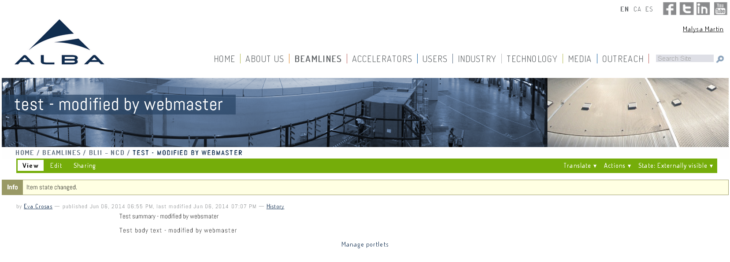

Slide 14
How to Modify Existing Content
Authorized editors may CHECK OUT an externally visible item to create a working copy of the page

Slide 15
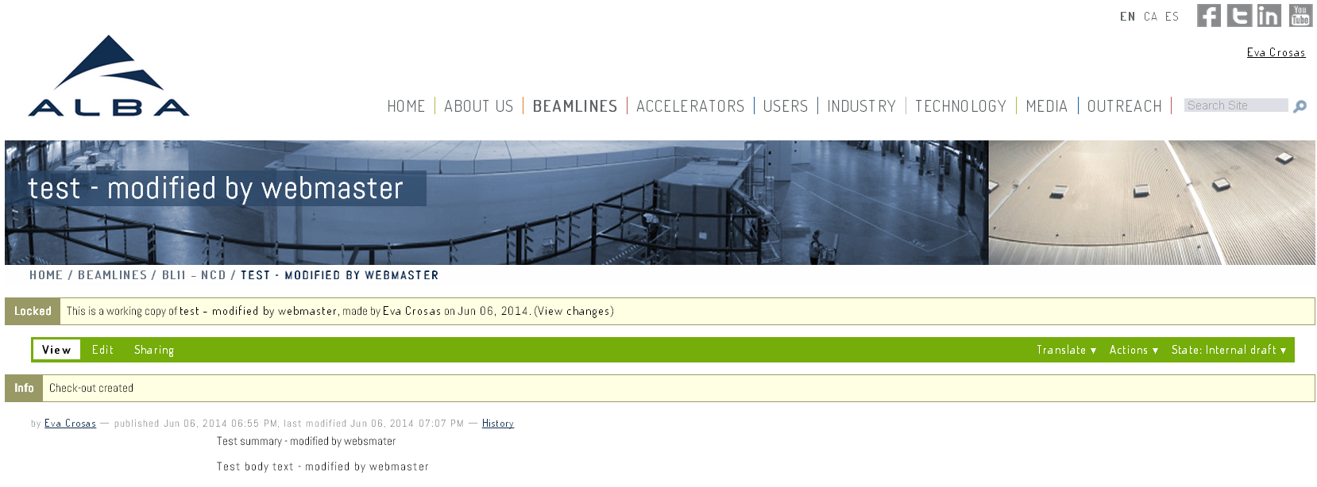
Authorized editors can edit the working copy of page

Slide 16
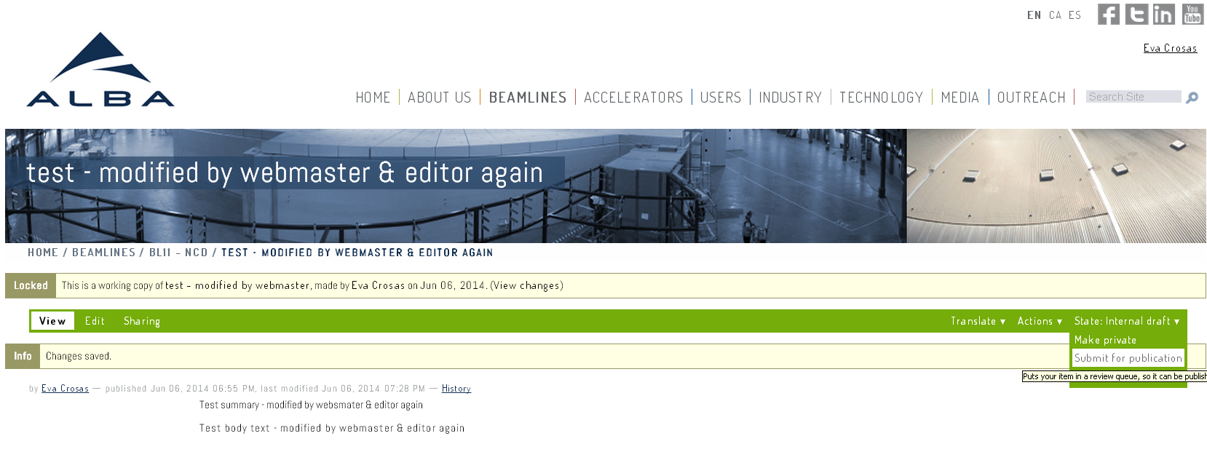
Authorized editors can submit the new content for publication. A notification is automatically sent to the webmasters.

Slide 17
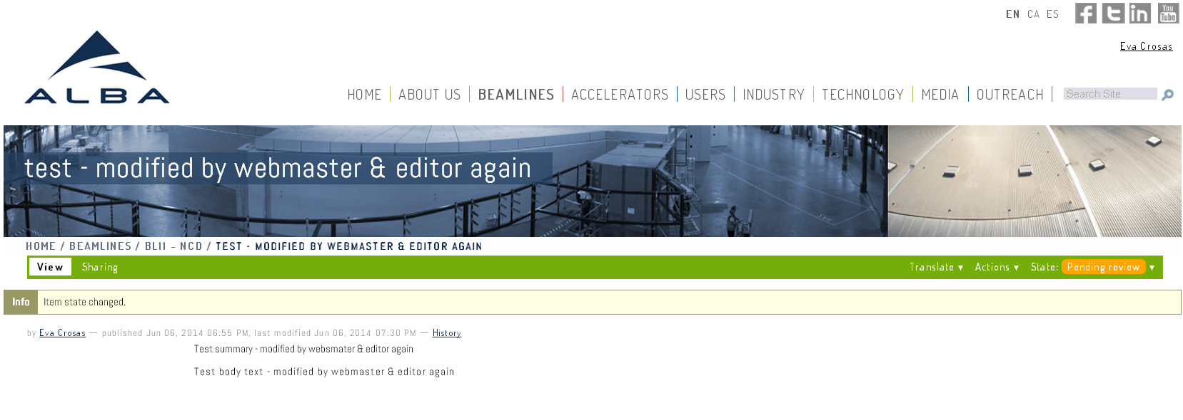

Slide 18
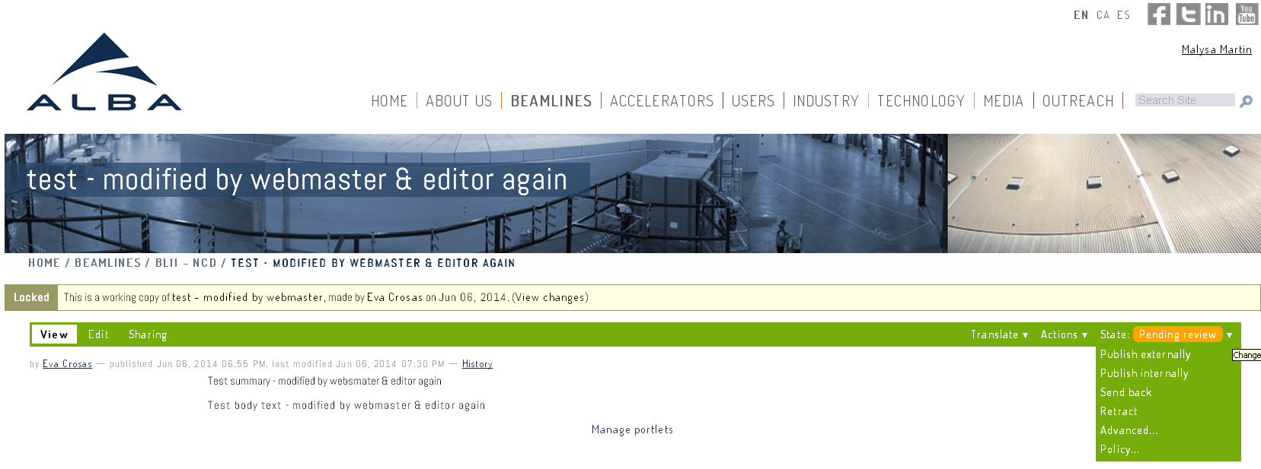
WARNING FOR WEBMASTERS!!!
Publishing a working copy will create a new visible page instead of merging the changes into the published page.

Slide 19
What can the public see?
Content previously published externally by the webmaster.

Slide 20
What can the public see?

Slide 21
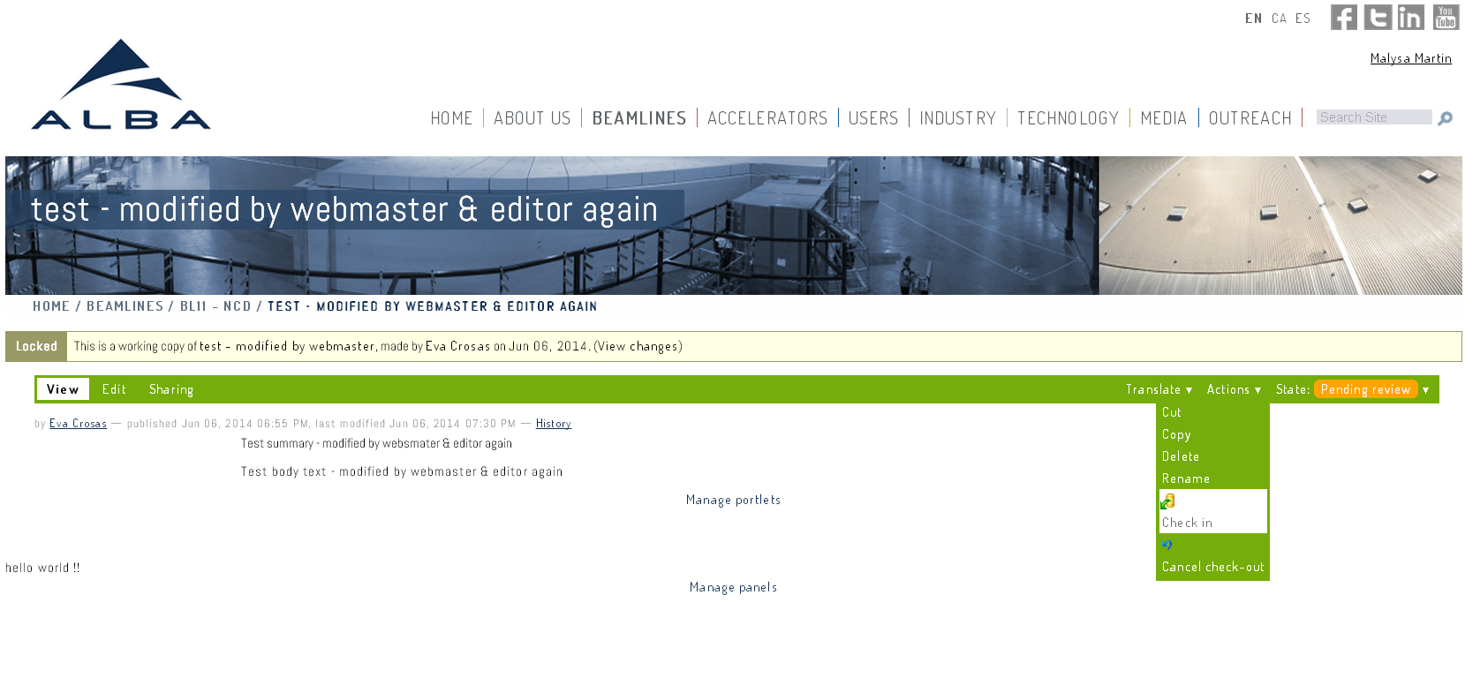
Webmasters:
Receive a submission notification by email
Review the content and format
Actions / CHECK IN to publish the modifications
Actions/ CANCEL CHECK OUT to reject the proposed changes.

Slide 22
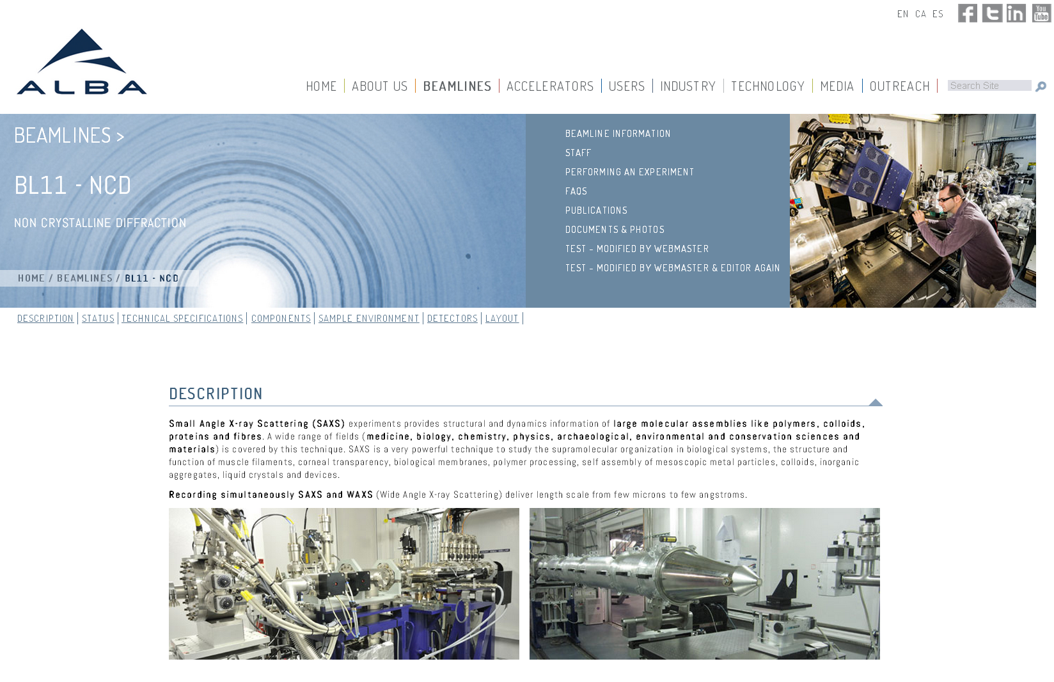

Slide 23
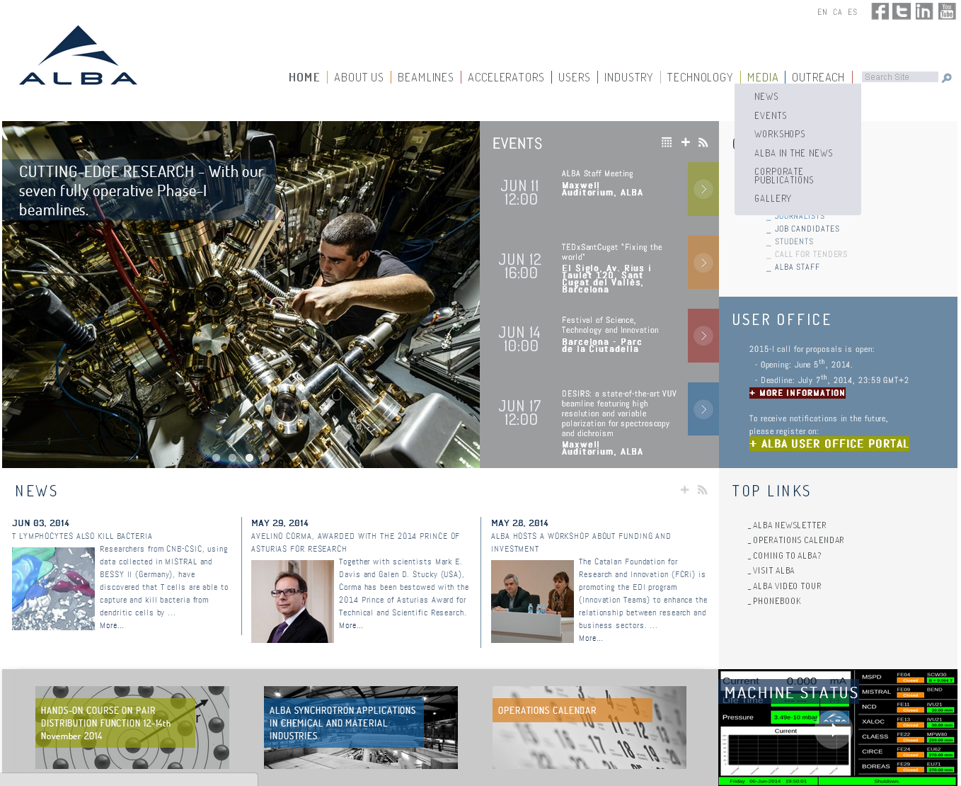
How to Publish Events

Slide 24
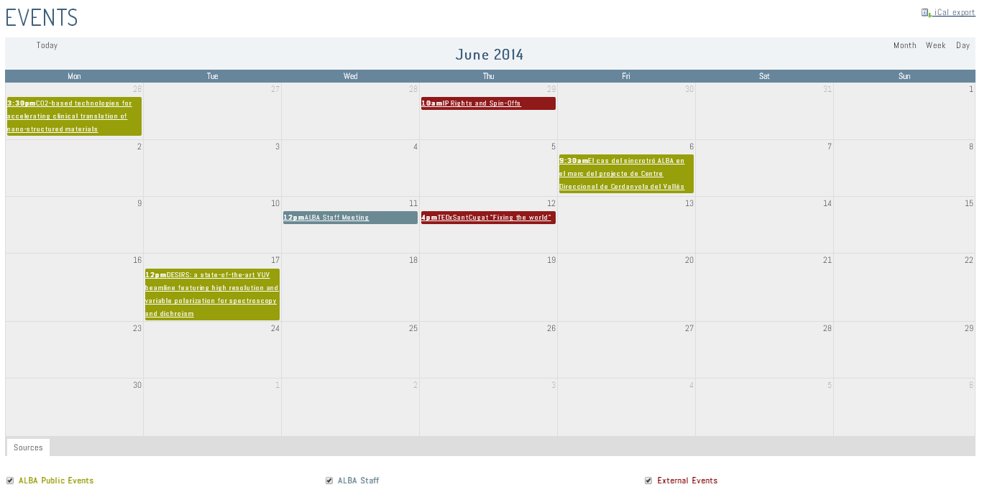
CALENDAR

Slide 25
How to Add an Event?
The three types of events differentiated by the folder they are in:
ALBA Public Events www.albasynchrotron/en/media/events/alba-public-events/folder_contents
ALBA Staff www.albasynchrotron/en/media/events/alba-staff/folder_contents
External Events www.albasynchrotron/en/media/events/external-events/folder_contents

Slide 26
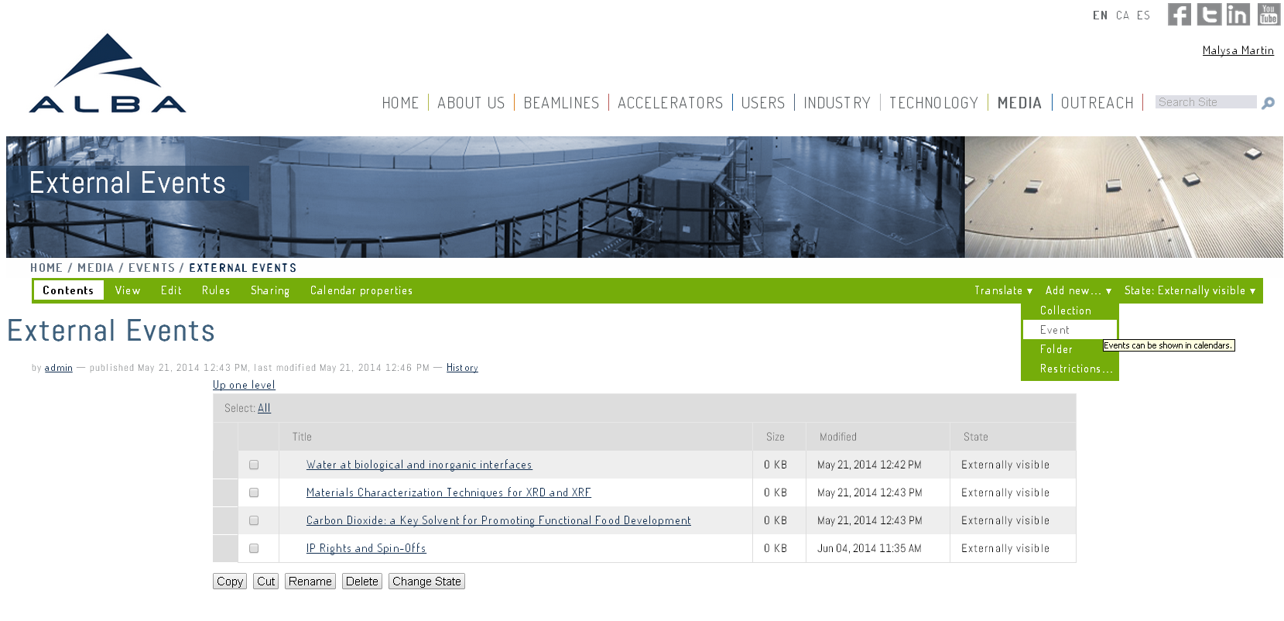

Slide 27
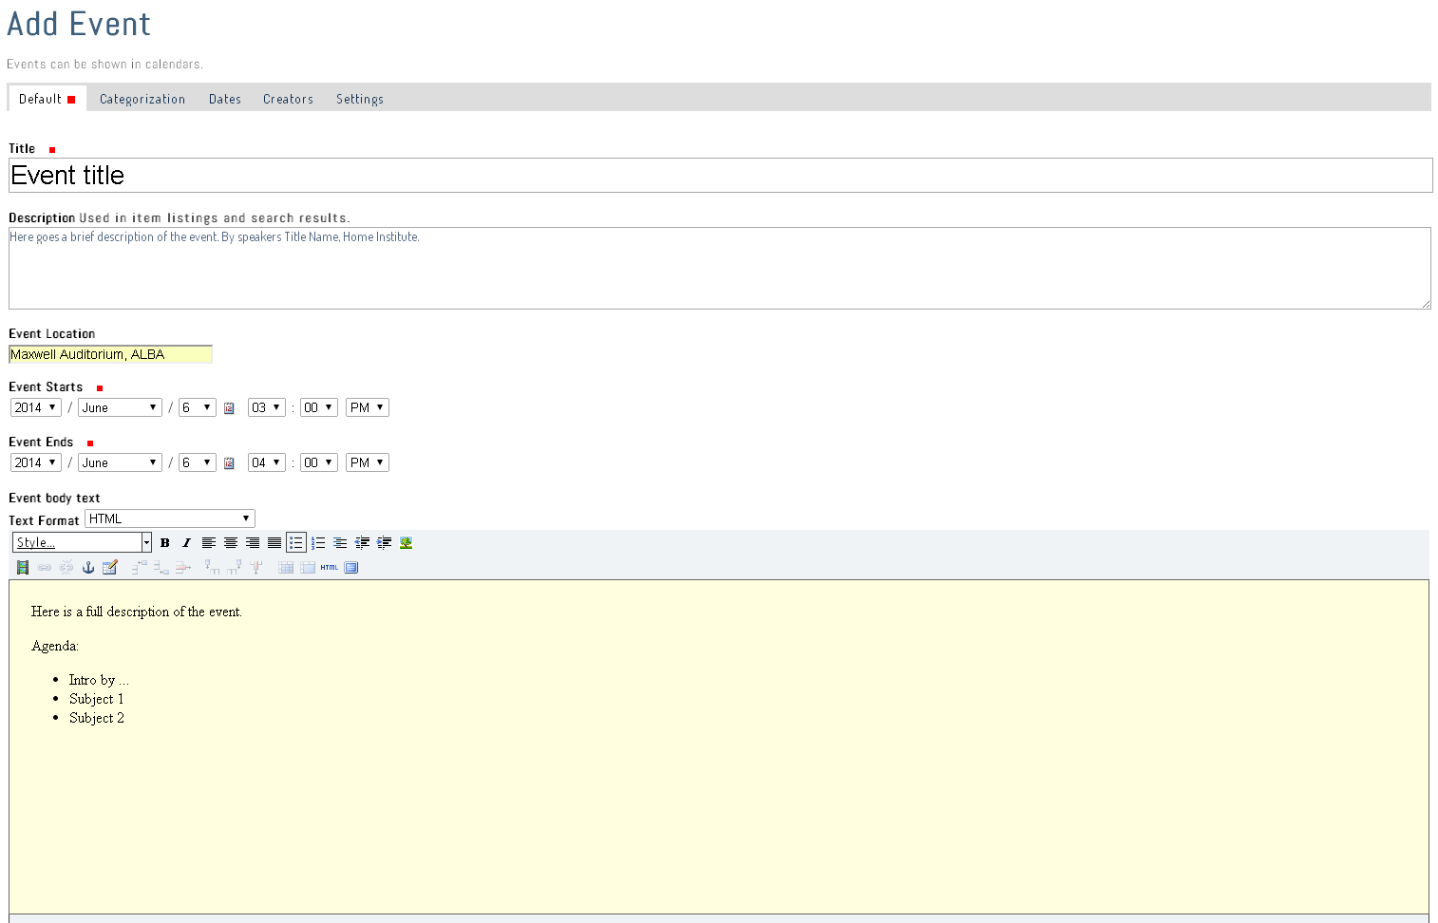
1
2
3
4
5

Slide 28
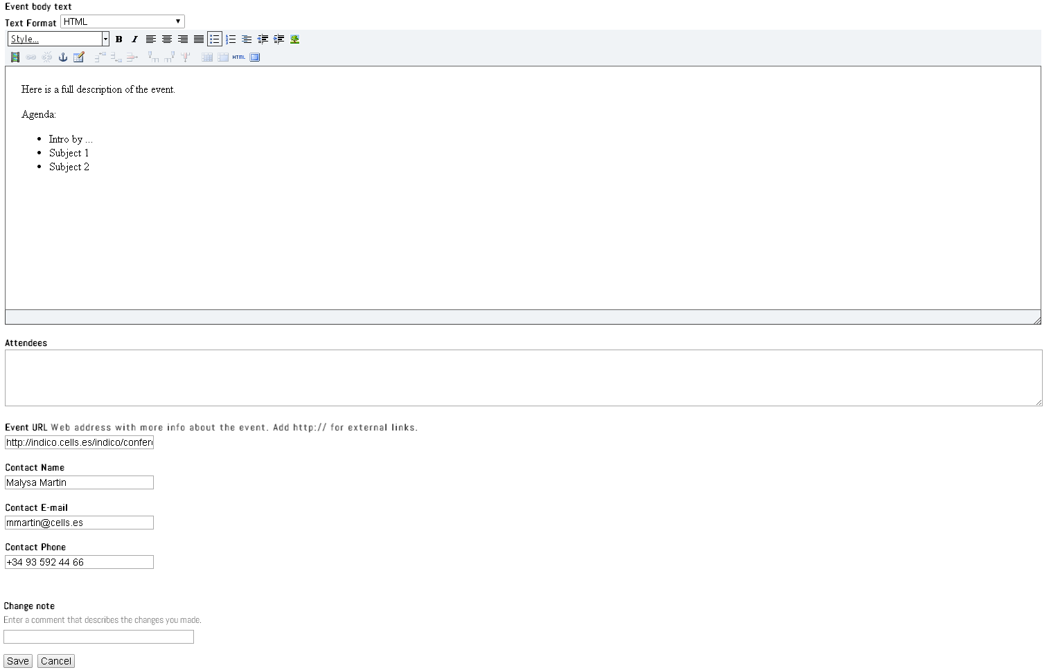
6
7
8
9
10

Slide 29
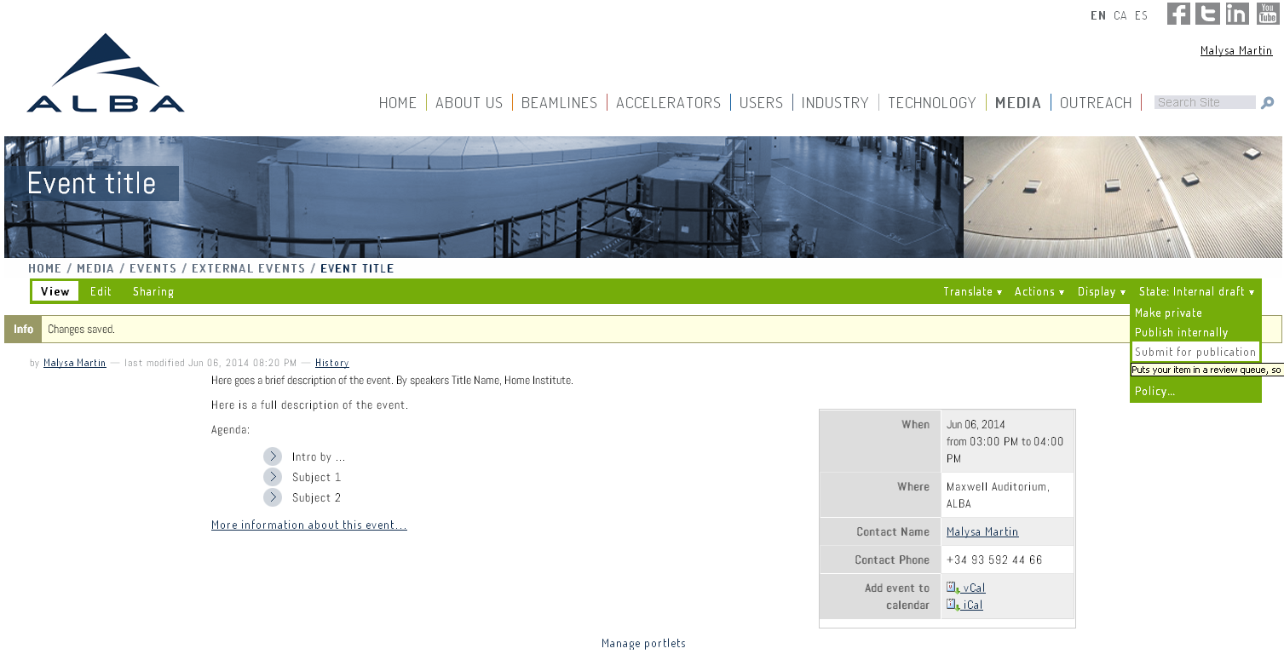
Submit for Publication

Slide 30
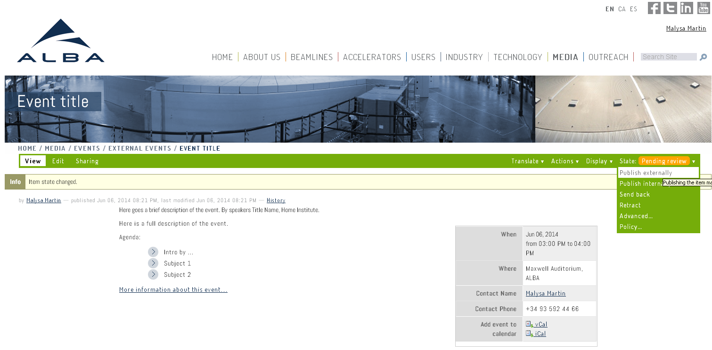
Publish externally

Slide 31
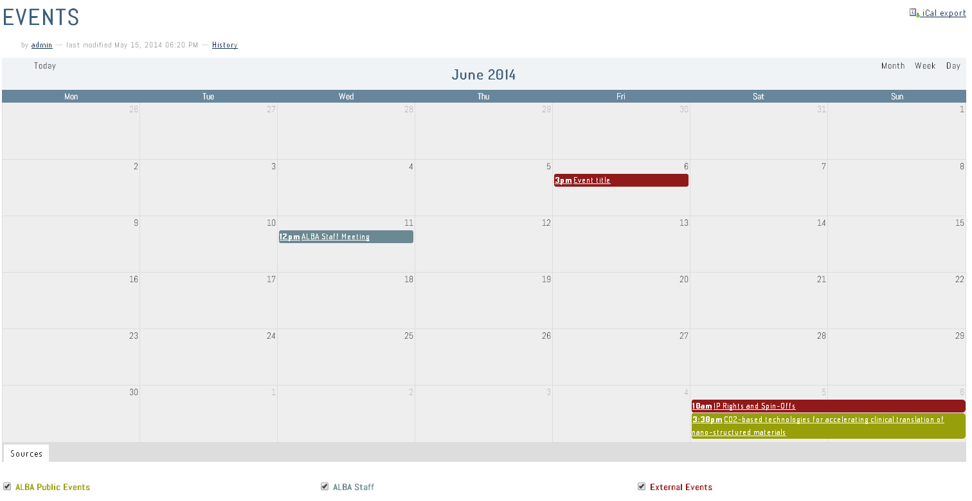

Slide 32
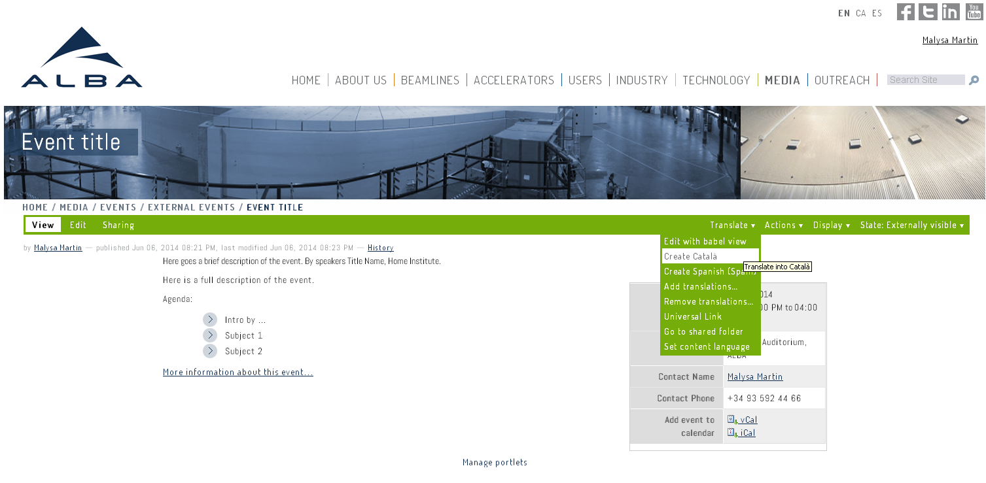
Create the Catalan translation

Slide 33
Create the Catalan translation

Slide 34
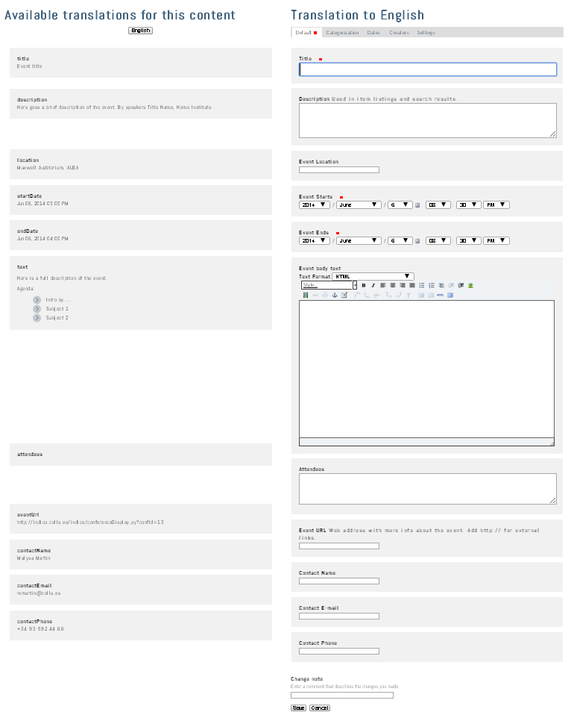
1
2
3
4
5
6
7
8
9
10

Slide 35
Create the Spanish translation and repeat...

Slide 36
Questions?

